Slide 1
Dress For Success
Army JROTC

Slide 2
What is Dress for Success (DFS)?
Dress for Success (DFS) is done every Tuesday in order instill professionalism into all cadets, and to prepare them for when they join the workforce.
It is worth 15% of each cadet’s grade.
You are required to not only meet the professional standards set in JROTC, but you must also be in compliance with the Dress Code (CODE #31 pg. 10) of the High School Code of Conduct (14-15)
For Dress for Success you are required to wear your professional dress for the entire day (with the exception for those who have P.E, automotive, etc.)
If caught without professional wear at any time throughout the day you will receive an automatic ZERO for DFS that day, and in addition you will be required to wear professional wear for the rest of the week.

Slide 3
High School Code of Conduct: DRESS CODE (CODE #31 pg. 10)
Shirts & Blouses
No halter tops
No spaghetti straps
Skirts & Dresses
Appropriate length would be at fingertips, provided this measurement is mid-thigh and below
No mini-skirts
1st Offense
Warning
2nd & 3rd Offense
Detention
4th Offense
Principal’s Discretion

Slide 4
Dress For Success Rules: Males

Slide 5
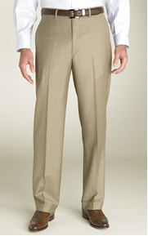
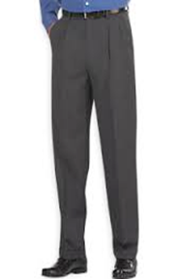
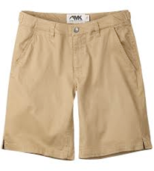
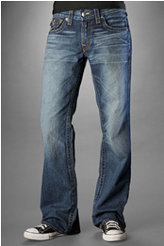
Dress For Success Rules: Pants
ALL males must wear either kakis or slacks. NO shorts or jeans!

Slide 6
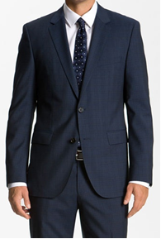
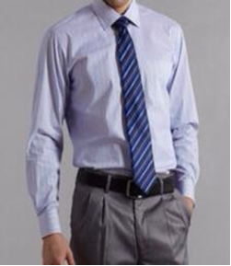
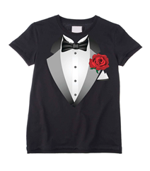
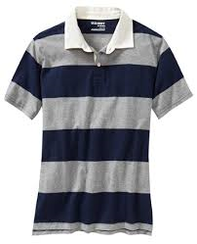
Dress For Success Rules: Shirts
ALL males must wear a collared shirt with either a tie or a bowtie.

Slide 7
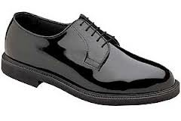
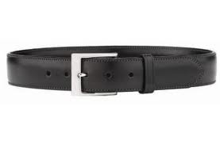
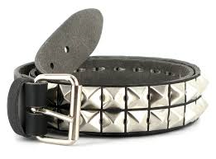
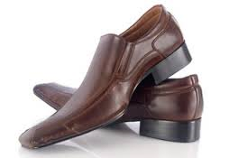
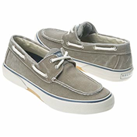
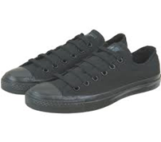
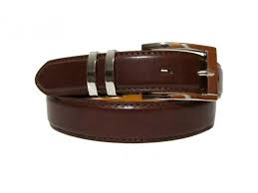
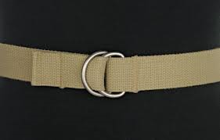
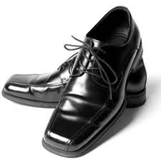
Dress For Success Rules: Belts & Shoes
Belts
Shoes
ALL males must wear a belt (black or brown).
ALL males must wear dress shoes (YOU MAY NOT WEAR YOUR UNIFORM SHOES)!

Slide 8
Dress For Success Rules: Females

Slide 9
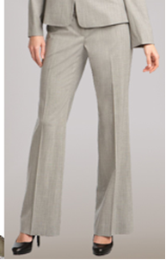
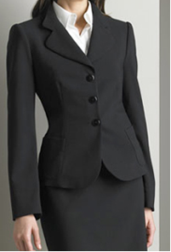
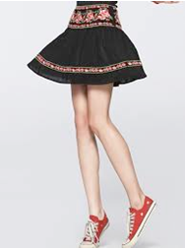
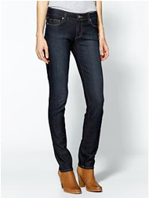
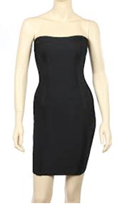
Dress For Success Rules: Skirts, Dresses, & Pants
ALL females must wear a skirt, dress, or slacks/pantsuit. NO shorts or jeans!
ALL dresses/skirts must be no shorter than 1 INCH above the knee, and they CANNOT BE STRAPLESS OR HAVE SPAGETTI STRAPS.

Slide 10
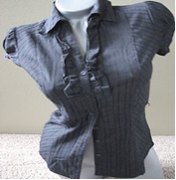
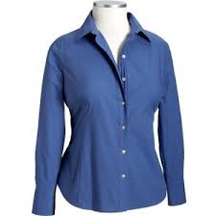
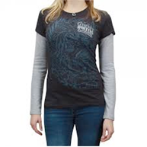
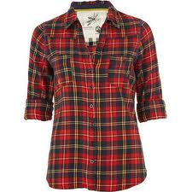
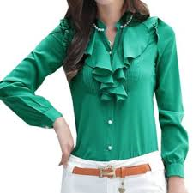
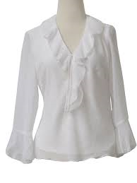
Dress For Success Rules: Shirts/Blouses
ALL females must wear a nice/professional shirt/blouse.

Slide 11
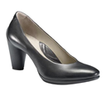
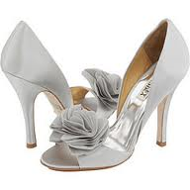
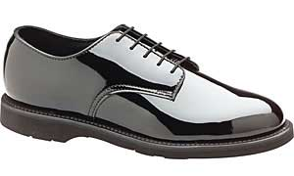
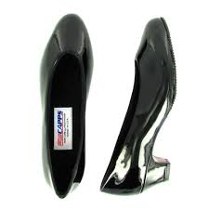
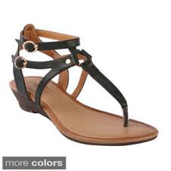
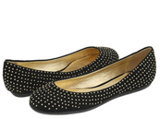
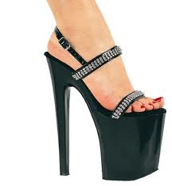
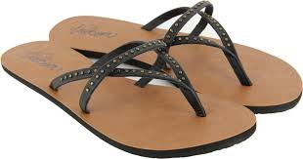
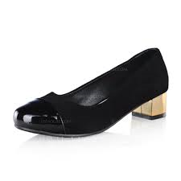
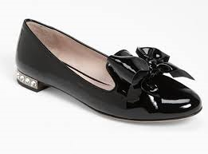
Dress For Success Rules: Shoes
ALL females must wear shoes that have a 1-INCH heel (YOU MAY NOT WEAR YOUR UNIFORM SHOES OR FLATS)

Slide 12
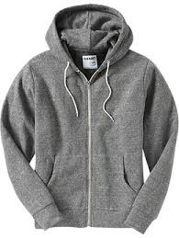
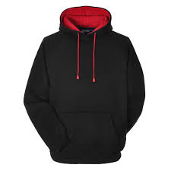
Dress For Success: Hoodies
ALL hoodies must be off during school hours for DFS. Exceptions to this rule include when there is a fire drill (in which students must go outside), or if given permission by a JROTC instructor.

